Slide 1
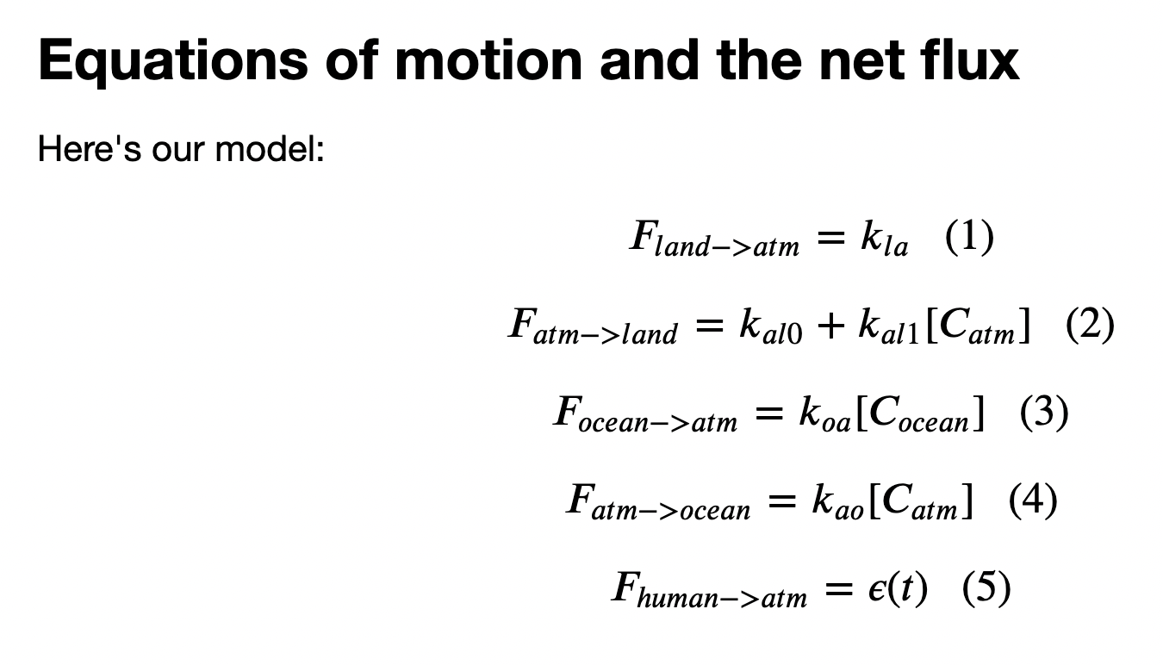
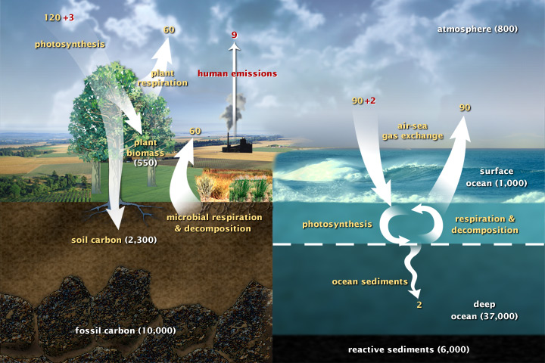
Focusing next on Eq. 4: The atmosphere => ocean flux

Slide 2
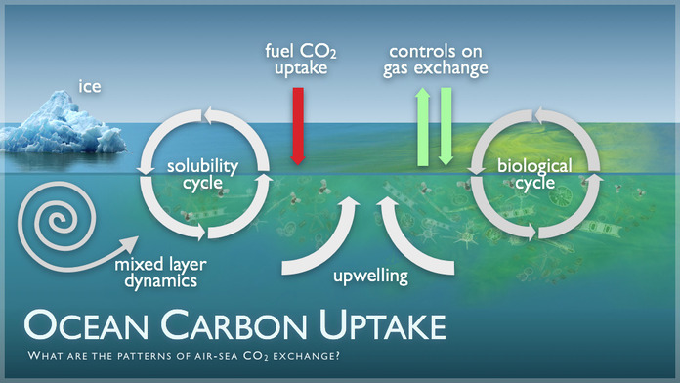
The atmosphere -> ocean CO₂ flux is mainly controlled by two cycles: solubility and biological
https://useruploads.socratic.org/IrMMNZtRkSNQVVLC2Kbe_pmel-research.003_med.jpg

Slide 3
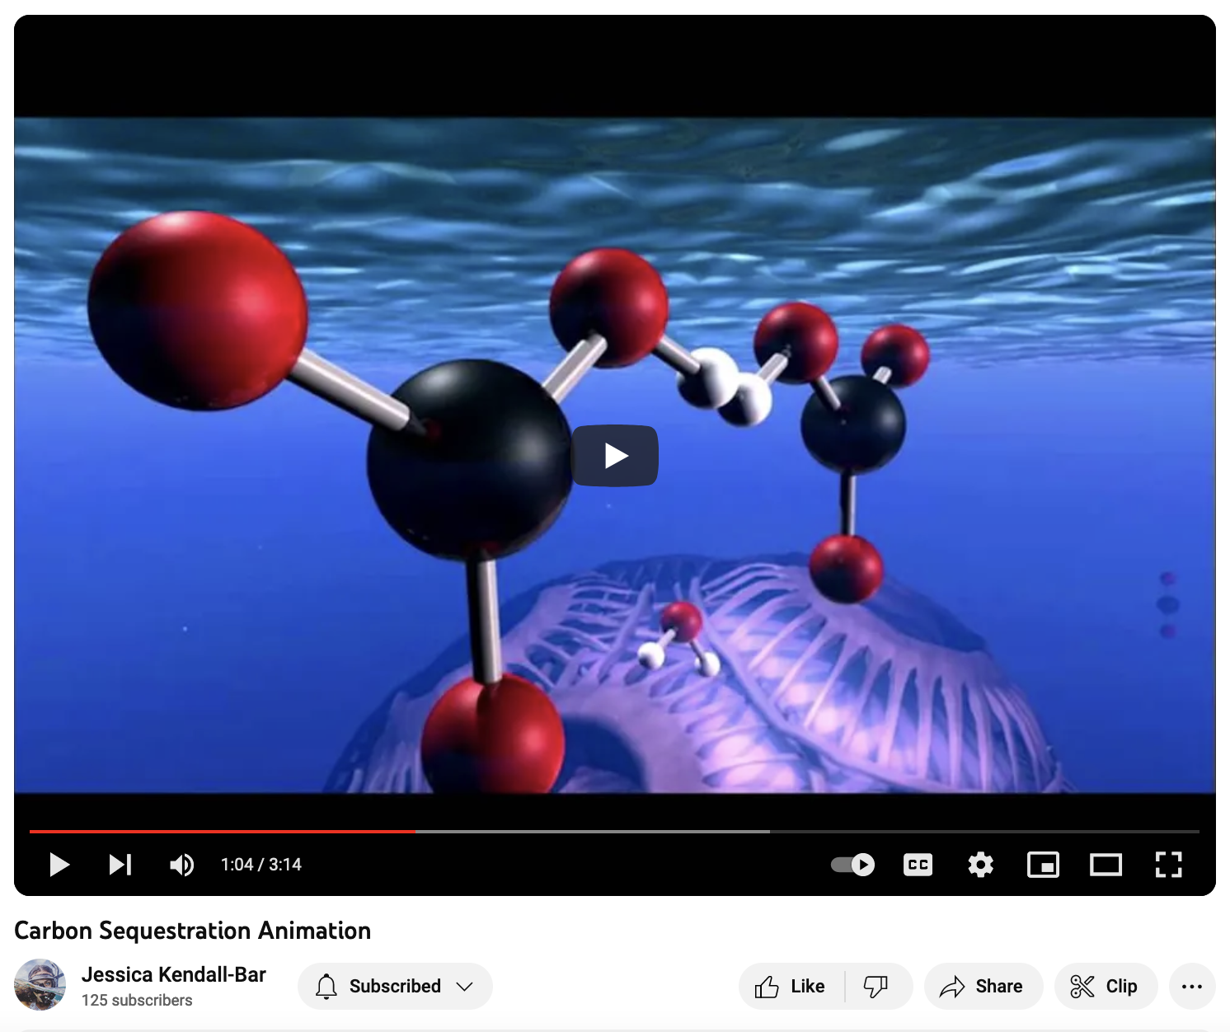
Here’s the biological cycle
https://youtu.be/tQh_28UOcVg?t=64

Slide 4
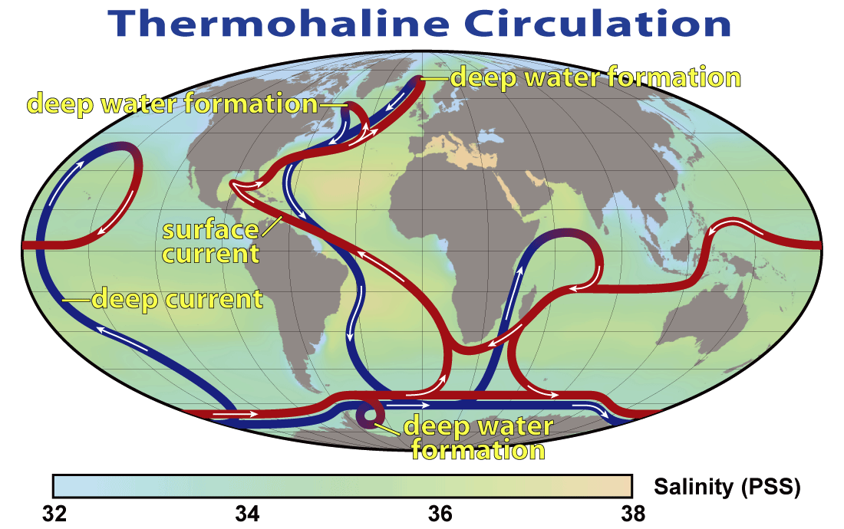
The solubility cycle is depends a lot on the AMOC*
*Atlantic Meridional Ocean Circulation. Also referred to as Thermohaline circulation.
By Robert Simmon, NASA. Minor modifications by Robert A. Rohde also released to the public domain - NASA Earth Observatory, Public Domain, https://commons.wikimedia.org/w/index.php?curid=3794372

Slide 5
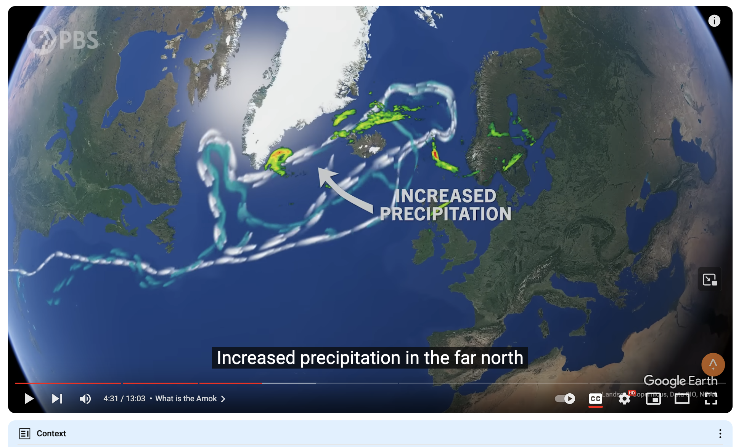
Here’s the how the AMOC relates to the solubility cycle
https://www.youtube.com/watch?v=4CXZi-gFgX4

Slide 6
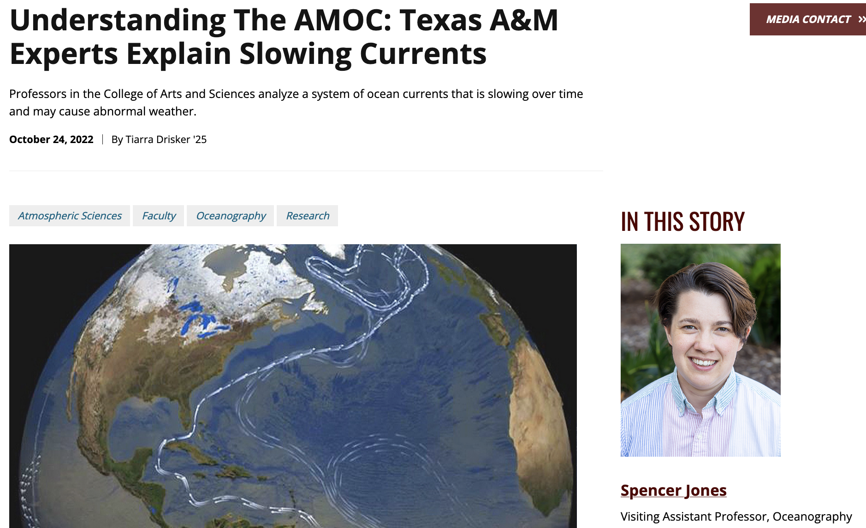
Warming => slower AMOC => reduced removal of atmospheric CO₂ => more warming
“If the AMOC slows down, less carbon dioxide and heat will be taken up by the deep ocean and more will end up in the atmosphere, causing temperatures to be higher at the Earth’s surface.”
https://artsci.tamu.edu/news/2022/10/understanding-the-amoc-texas-aandm-experts-explain-slowing-currents.html

Slide 7
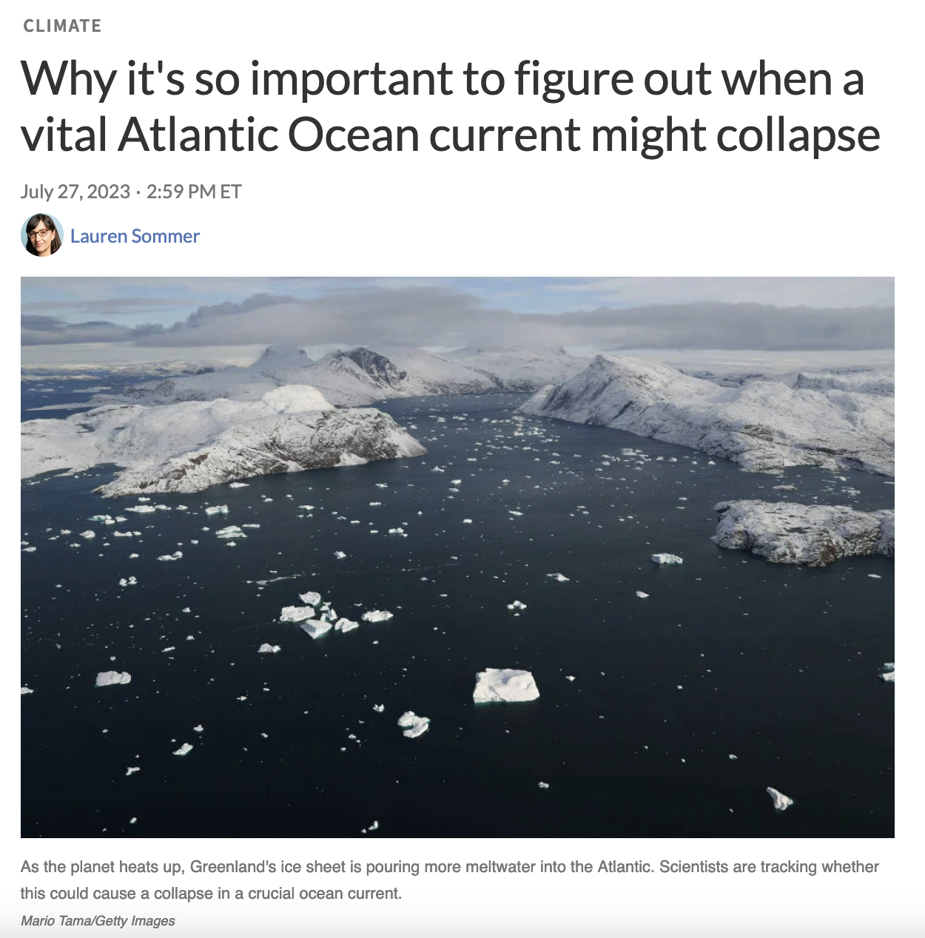
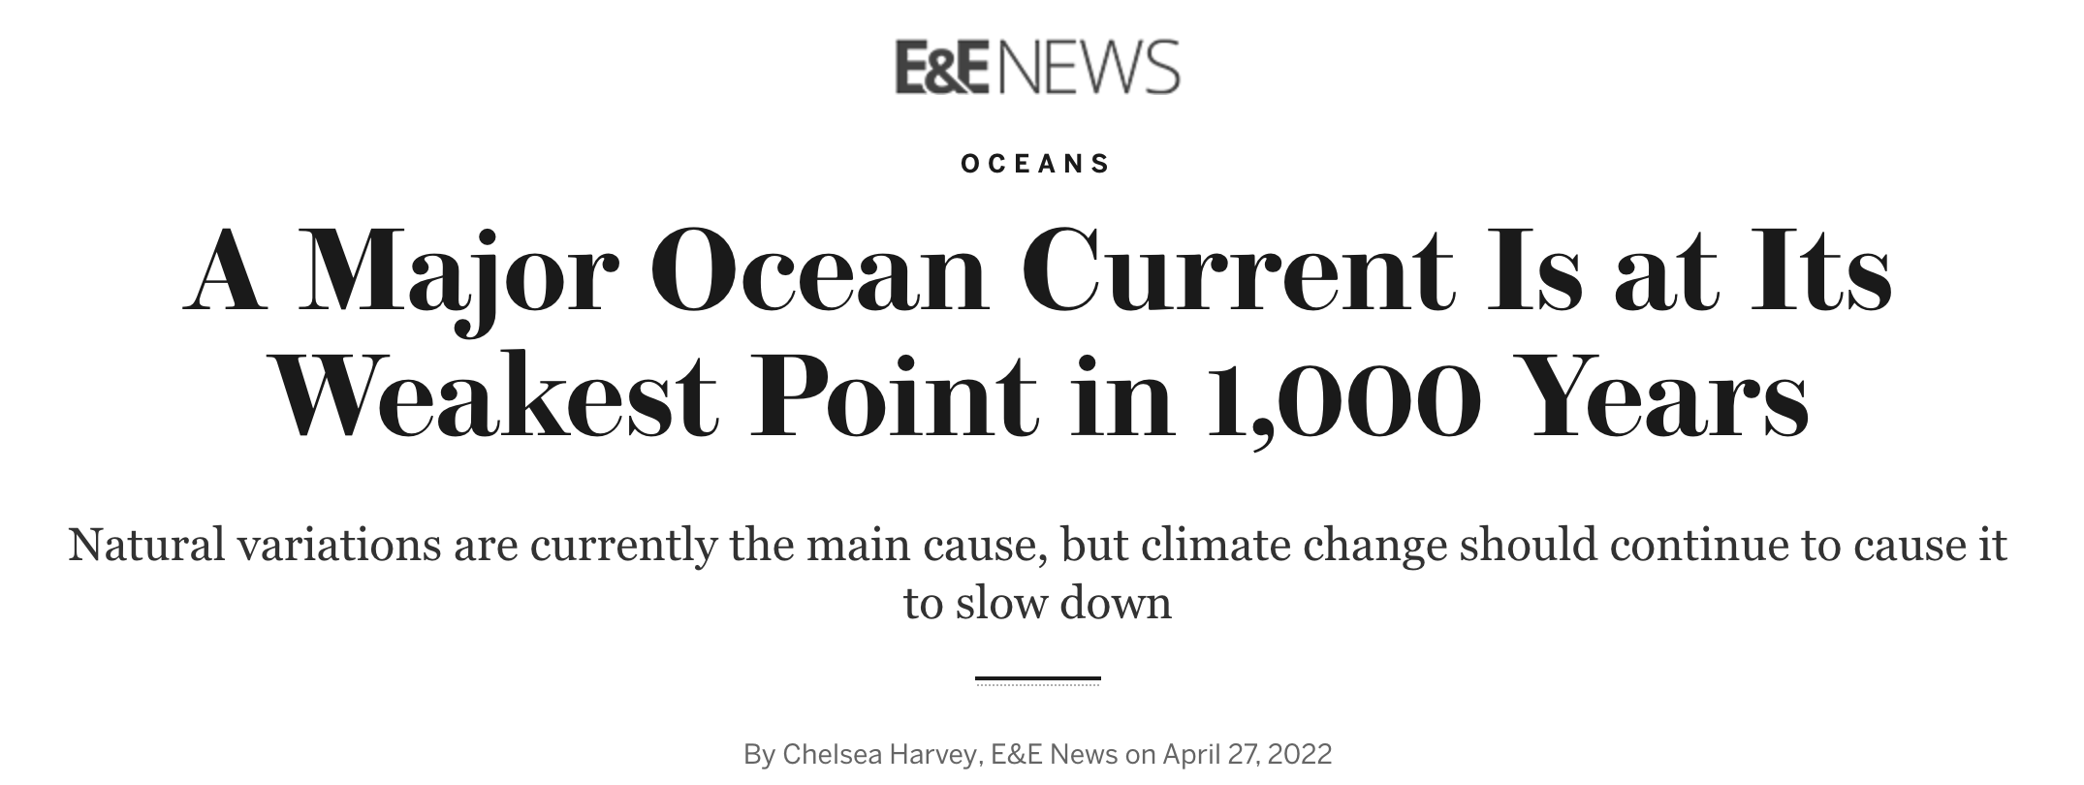
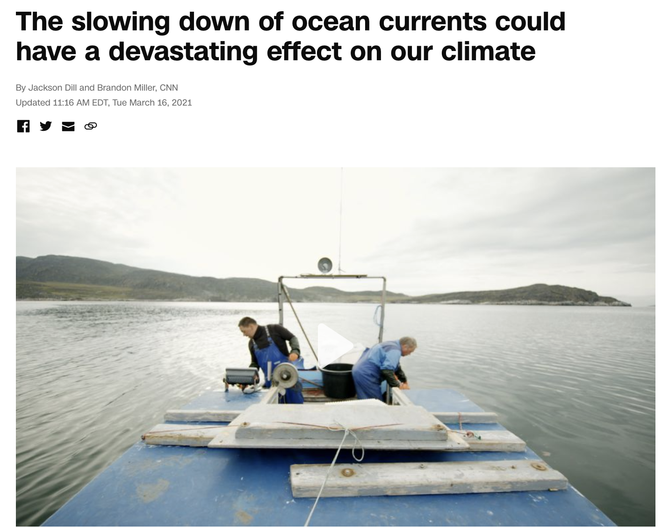
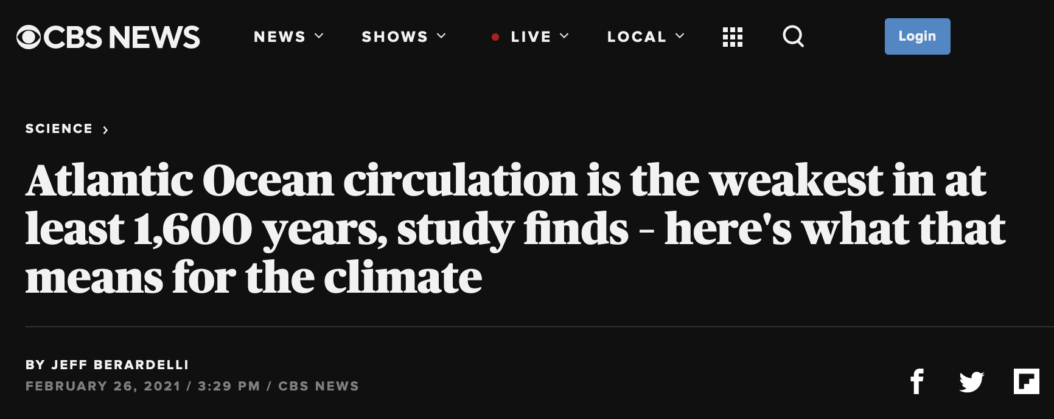
The AMOC has slowed down

Slide 8
In summary: Eq. 4 tries to represent both the biological cycle and solubility cycle

Slide 9
Focusing next on Eq. 3: CO₂ coming out of the ocean

Slide 10
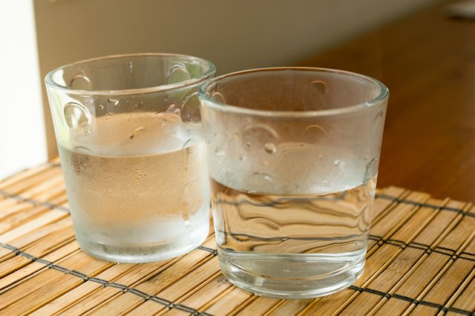
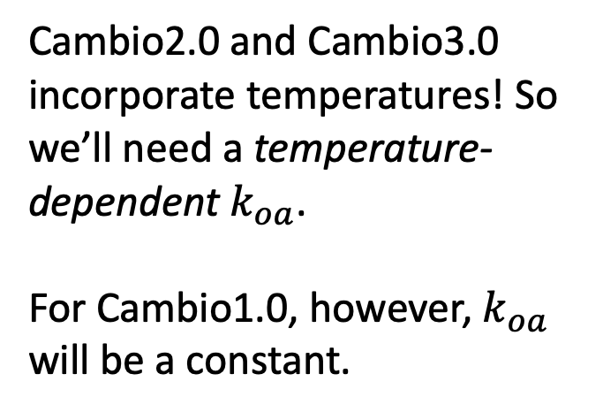
Warm water gets rid of dissolved CO₂ faster than cold water
Cambio2.0 and Cambio3.0 incorporate temperatures! So we’ll need a temperature-dependent $k_{oa}$.
For Cambio1.0, however, $k_{oa}$ will be a constant.
Cold ocean
Warm ocean

Slide 11
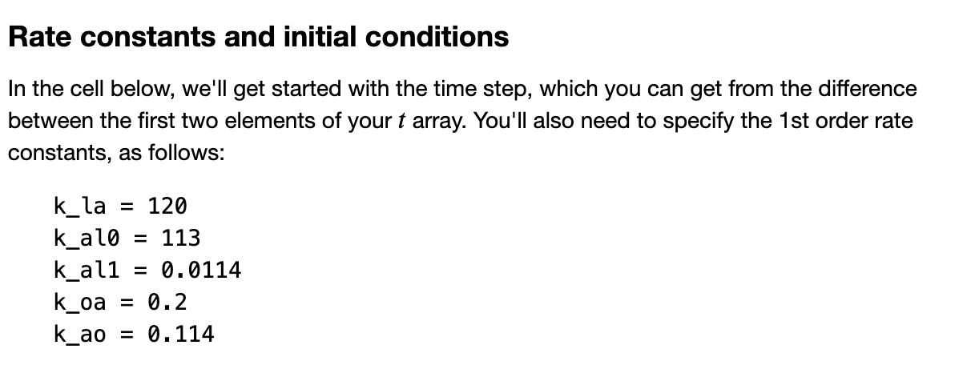
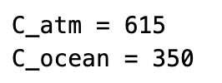
So here are all the constants, initial conditions, and fluxes needed for Cambio1.0

Slide 12
You’ll upload an emissions scenario from ScheduledFlows

Slide 13
Your Euler loop will solve for the amount of carbon in the atmosphere and oceans over time!

Slide 14
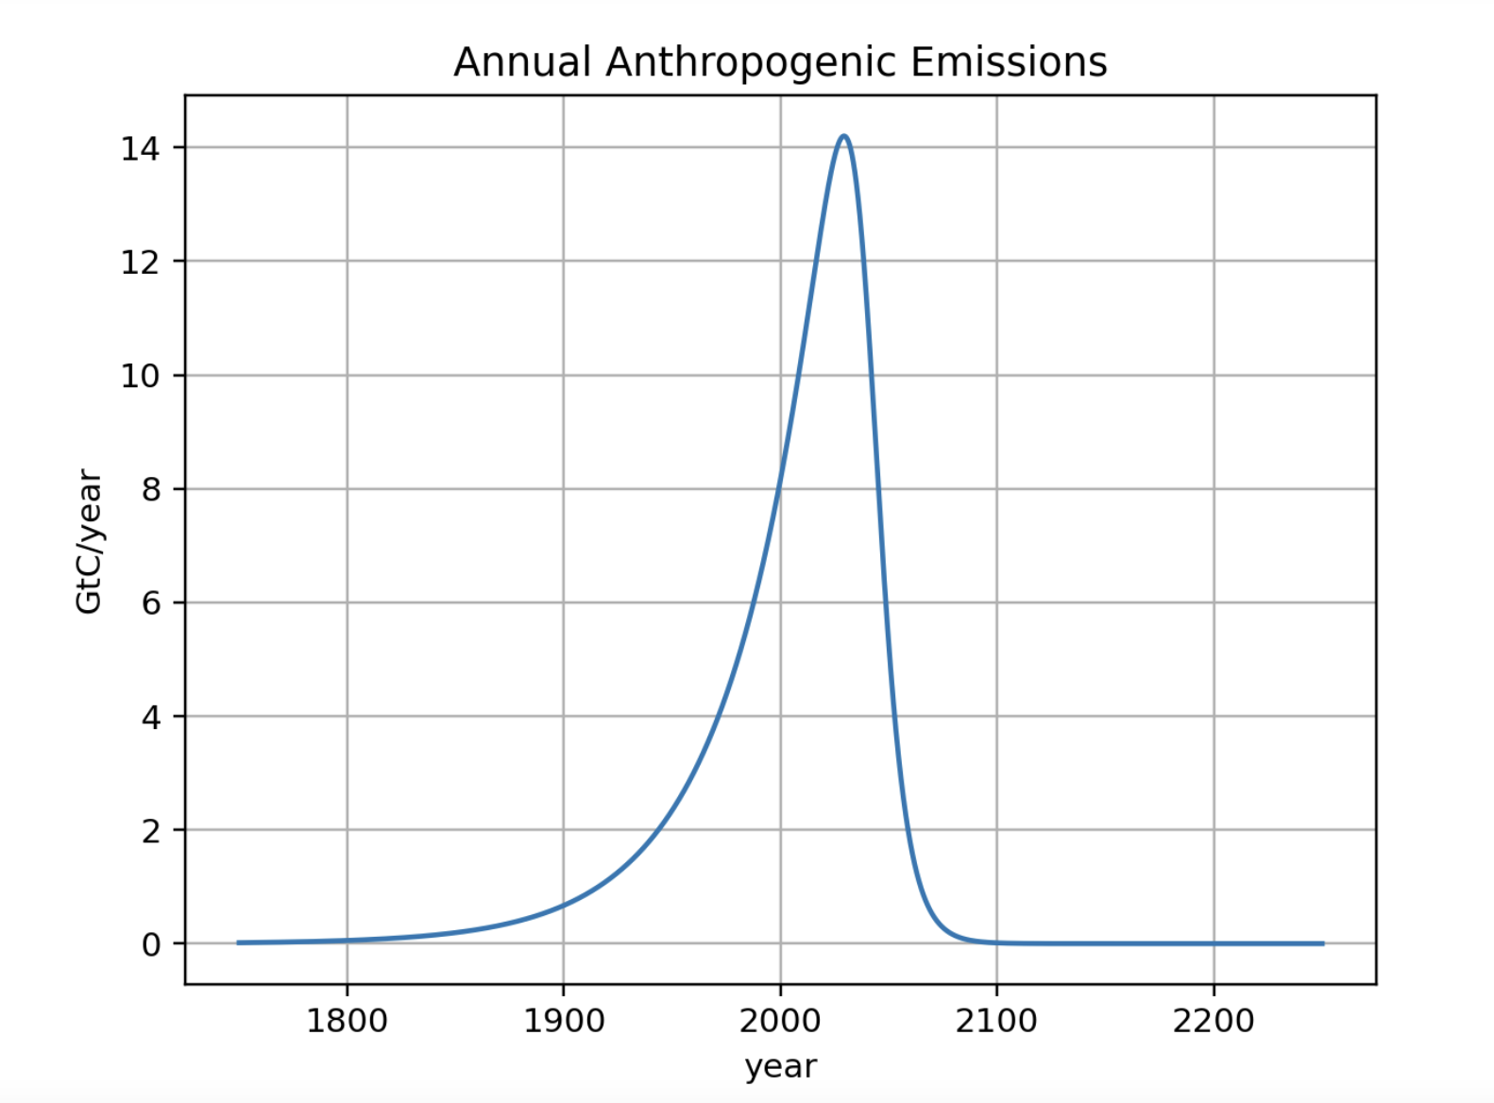
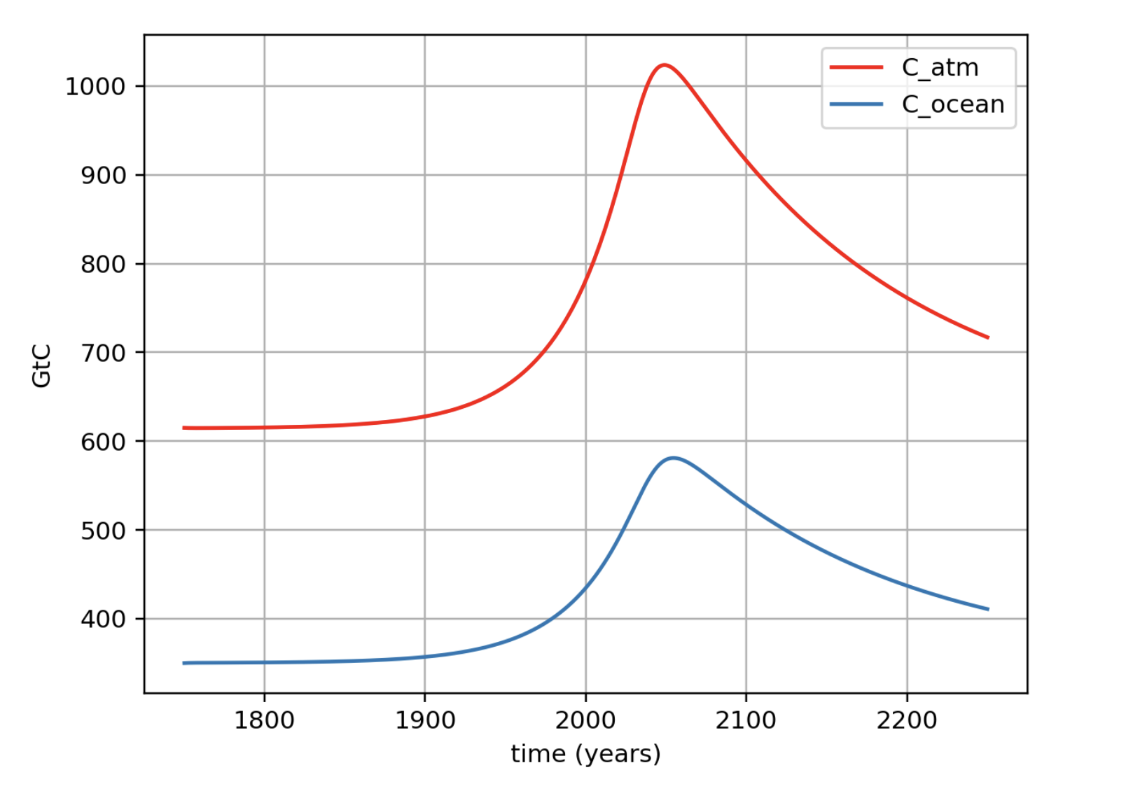
A peek into the output: the time delay between peak emission and peak concentration
For this emissions scenario …
... here are the amounts of Carbon (GtC) in the climate system.

Slide 15
A peek into the output: the time delay between peak emission and peak concentration
For this emissions scenario …
You should study your output to figure out how long this delay is.
... here are the amounts of Carbon (GtC) in the climate system.

Slide 16
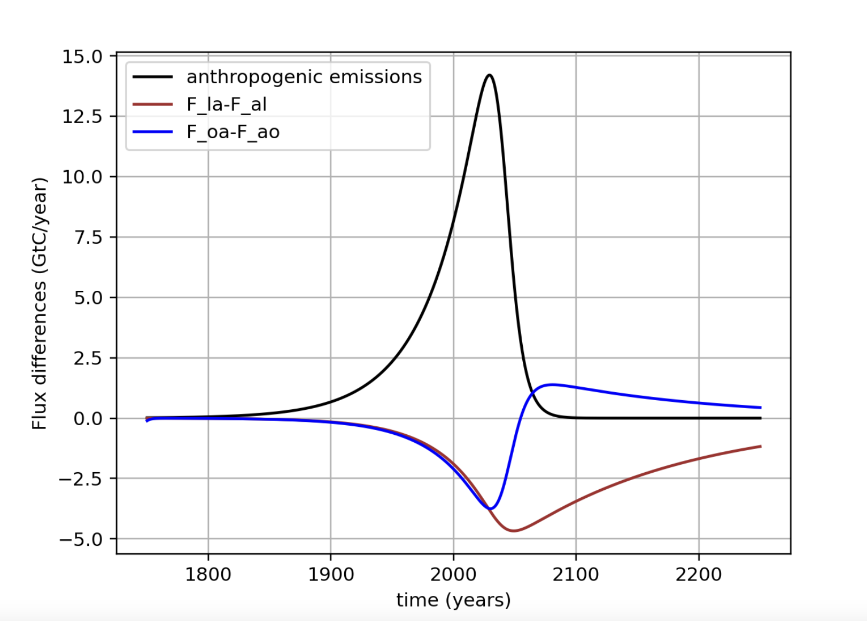
Also, net fluxes
Evidently, at the current time, oceans and land absorb about ¼ (each) of anthropogenic carbon emitted each year.

Slide 17
Also, net fluxes
Evidently, at the current time, oceans and land absorb about ¼ (each) of anthropogenic carbon emitted each year.
However, eventually oceans will start to give back some of their stored CO₂

Slide 18
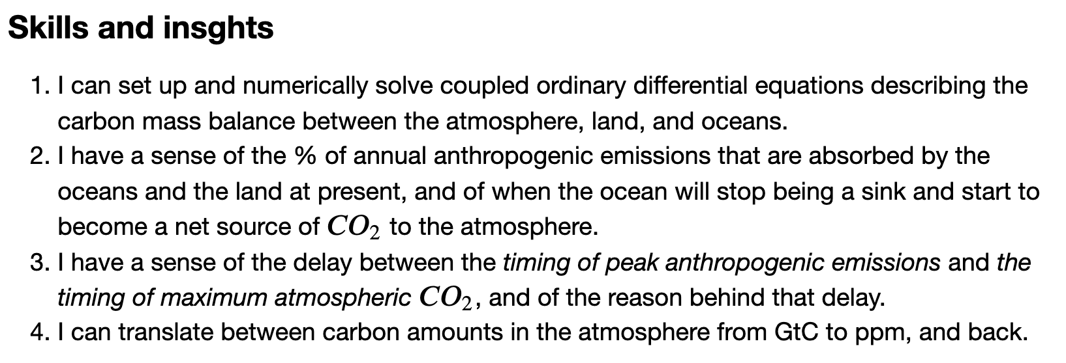
Week 6 – Cambio1.0

Slide 19
Extras below here

Slide 20
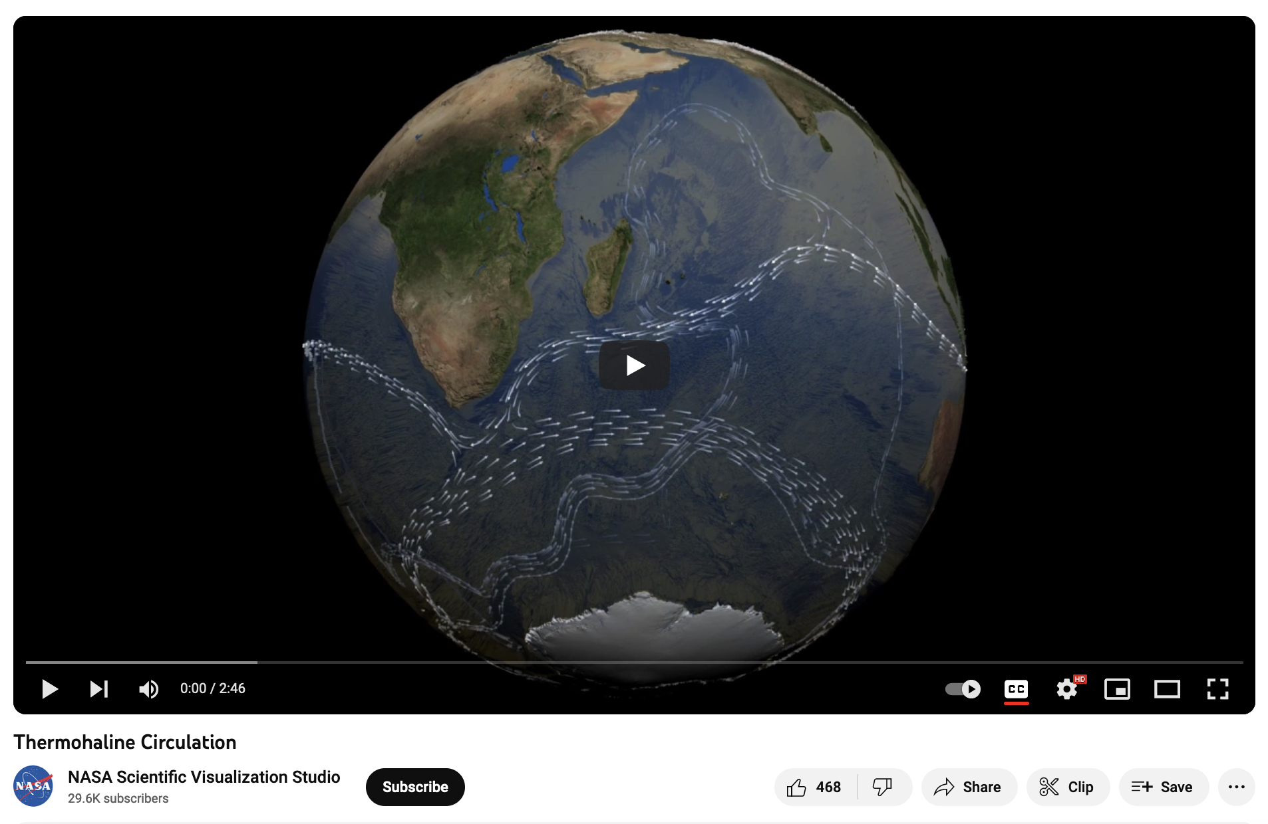
Here’s an animation of the AMOC
See especially the deep water formation happening off the southern tip of Greenland
https://www.youtube.com/watch?v=jOVvXDI0KbY

Slide 21
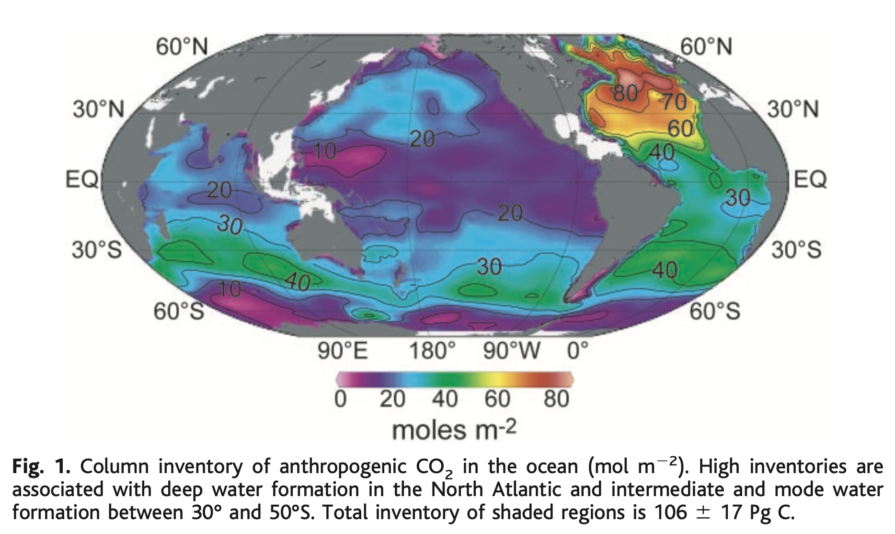
Waters off the southern tip of Greenland have been an important part of the solubility cycle

Slide 22
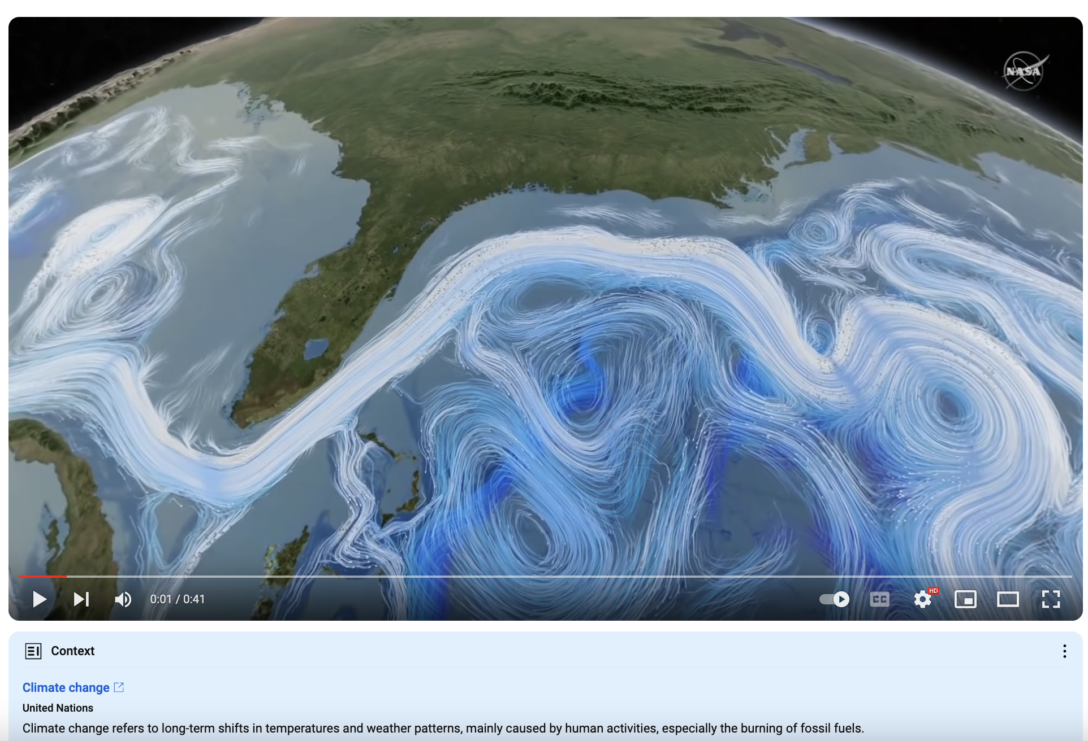
(Another good video of the AMOC)
https://www.youtube.com/watch?v=zauJQzti7FQ

